Slide 1
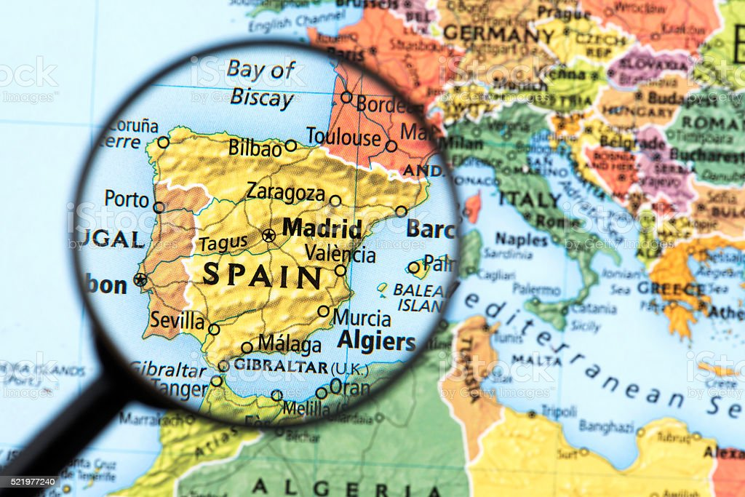
Spanish
A new start - Greetings, feelings and names
YEAR 3
Stage 1
Autumn 1
Key Vocabulary:
Knowledge Building Blocks:
I can say greetings in Spanish.
I can ask and answer about feelings.
I can introduce my name in Spanish.
Greetings Bank
Hola – hello
Buenos días – Good morning
Buenas tardes - Good afternoon / evening
Buenas noches – Good night
Hasta luego – See you soon
Adiós – Good bye
Sound spelling
“ho”
“bue”
“lla”
Question and Answer Bank
¿Cómo estás? – How are you?
Estoy bien. – I am good.
Estoy muy bien. – I am really good.
Estoy así así. – I am okay.
Estoy mal. – I am not good.
Estoy muy mal. – I am feeling really bad.
¿Cómo te llamas? - What are you called?
Me llamo… - I am called…
Grammar
When you ask a question in Spanish you can turn a sentence into a question by raising the pitch of your voice at the end of the question.
e.g.
¿Cómo estás?
¿Cómo te llamas?

Slide 2
Spanish
A new start – Numbers 0 -10
YEAR 3
Stage 1
Autumn 1
Knowledge Building Blocks:
I can say some numbers between 1 and 10.
I can recall numbers to 10.
Key Vocabulary:
Numbers Bank
cero - 0
uno - 1
dos - 2
tres - 3
cuatro - 4
cinco - 5
seis - 6
siete - 7
ocho - 8
nueve - 9
diez - 10
Sound spelling
“ce”
“ci”
“sei”
“ve”
“ez”
Fact Bank
The letter C sounds like an English “th” when it goes before the letters e (ce) or i (ci)
Practice saying these syllables:
Ca
Co
Cu
Ce
Ci

Slide 3
Spanish
YEAR 3
Stage 1
Autumn 1
A new start – Colours
Knowledge Building Blocks:
I can say 4 different colours in spanish.
Key Vocabulary:
Grammar Bank
Colours are words that describe objects.
We call them “adjectives”. Watch out in Spanish every time we meet the colours as the spelling might change to match the object the colour describes.
Colours Bank
azul - blue
blanco - white
rojo - red
negro - black
amarillo - yellow
verde – green
naranja – orange
rosa – pink
Sound spelling
“zul”
“jo”
“llo”
“ver”
Question Bank
¿Qué color es? - What colour is it?

