Slide 1
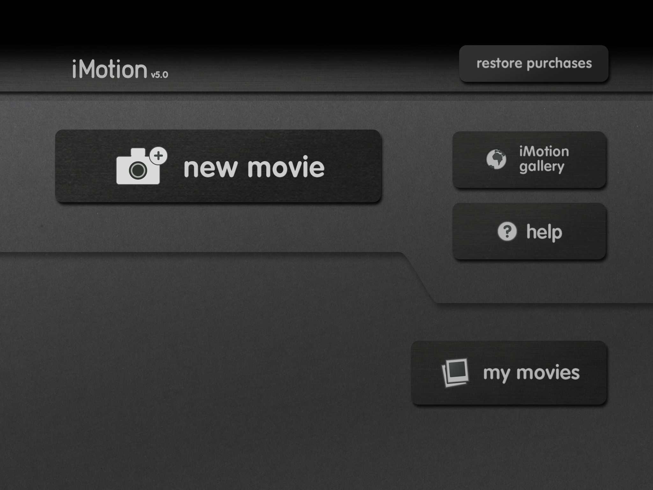
YEAR 3
Term 2
Creating Media – Animation
Key
Vocabulary:
animation
sequence
images
capturing device
storyboard
capture
onion skinning tool
subject position
frames
media
exported
shared
stop-frame animation
evaluate
Knowledge Building Blocks:
To explain that an animation is made up of a sequence of images.
To identify that a capturing device needs to be in a fixed position.
To set up the work area with an awareness of what will be captured.
To plan an animation using a storyboard.
To capture an image.
To use the onion skinning tool to review subject position.
To move a subject between captures.
To recognise that smaller movements create smoother animation.
To explain the need for consistency in working.
To review a captured sequence of frames as an animation.
To remove frames to improve an animation.
To explain the impact of adding other media to an animation.
To add media to enhance an animation.
To review a completed project.
To explain that a project must be exported so it can be shared.
Stop-Frame Animation:
Application:
iMotion
Media and Effects:
My Movie

