Slide 1
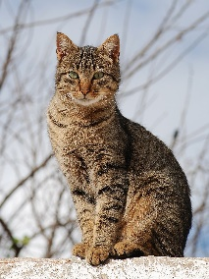
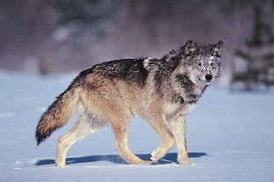
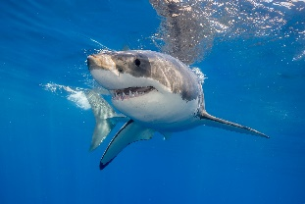
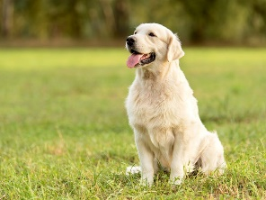
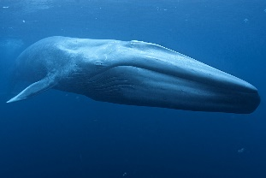
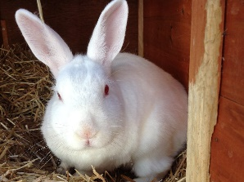
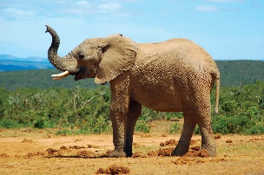
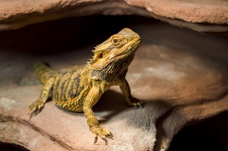
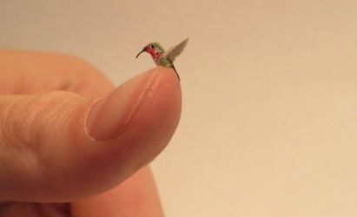
Pets or Predators?
Why are all animals not suitable as pets?
YEAR 1
Term 2
Key Vocabulary
pet
predator
carnivore
herbivore
habitat
wild animal
vet
Pets
Predators
Many of our pets are descended from dangerous animals. For example, dogs are in the wolf family and cats in the same family as lions and tigers.
Sharks are one of the most fearsome creatures on the planet. The great white shark is the largest predatory fish in nature. They can live for up to 70 years.
The largest animal is the Antarctic blue whale. Its tongue can weigh the same as an elephant!
The largest land animal is the elephant and they spend 16 hours a day just eating! Elephants are herbivores.
The world’s smallest bird is the bee hummingbird. Their wings beat 80 times a second.
A pet is an animal that lives in the home. Pets are usually animals that are safe to keep and are not a danger to others.
All pets were once wild animals
Pets need to be looked after carefully as they depend on humans to feed them and keep them safe and their habitat appropriate.
Different types of pets will need different food and different types of homes.
Some pets may need toys to keep them entertained.
A vet will look after your pet if they are unwell.

