Slide 1
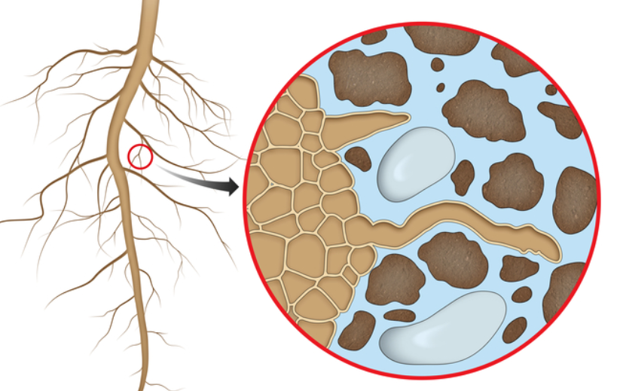
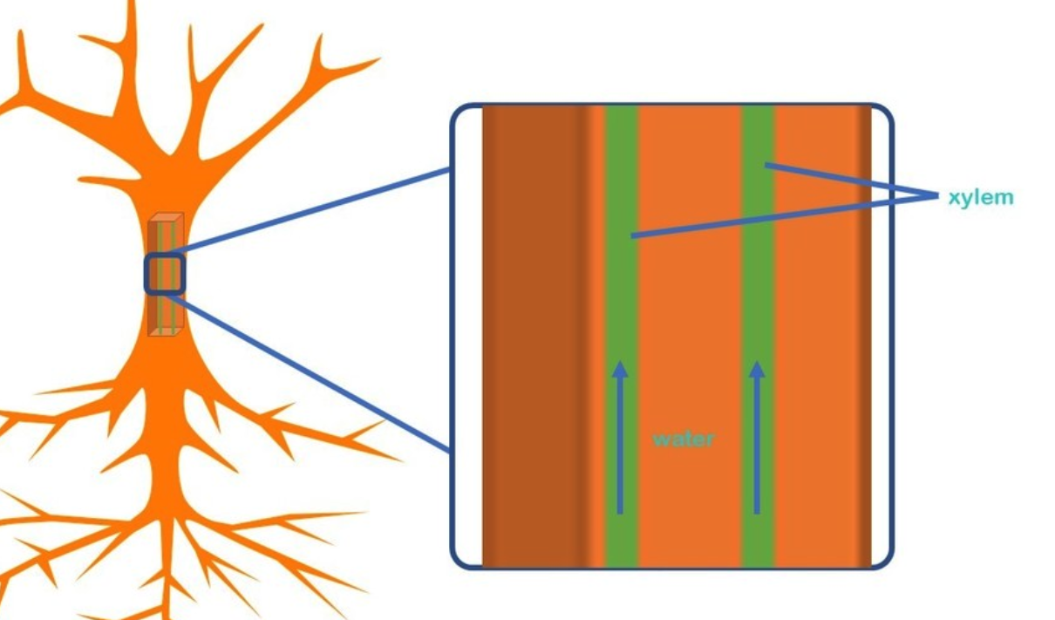
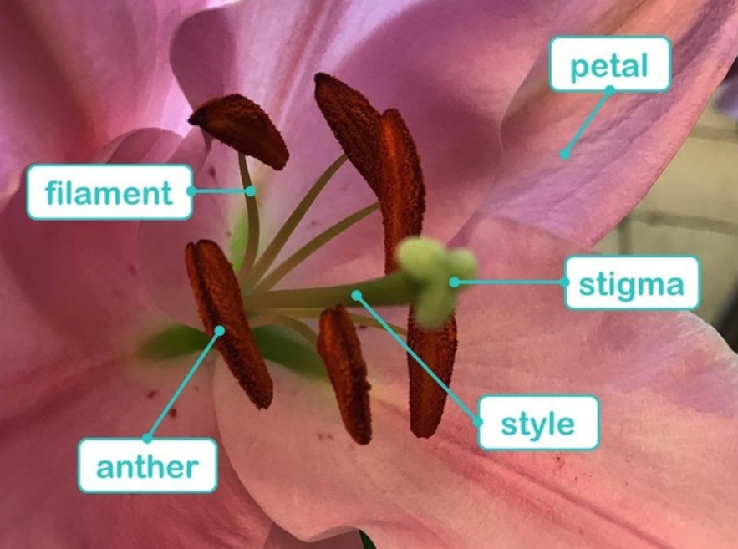
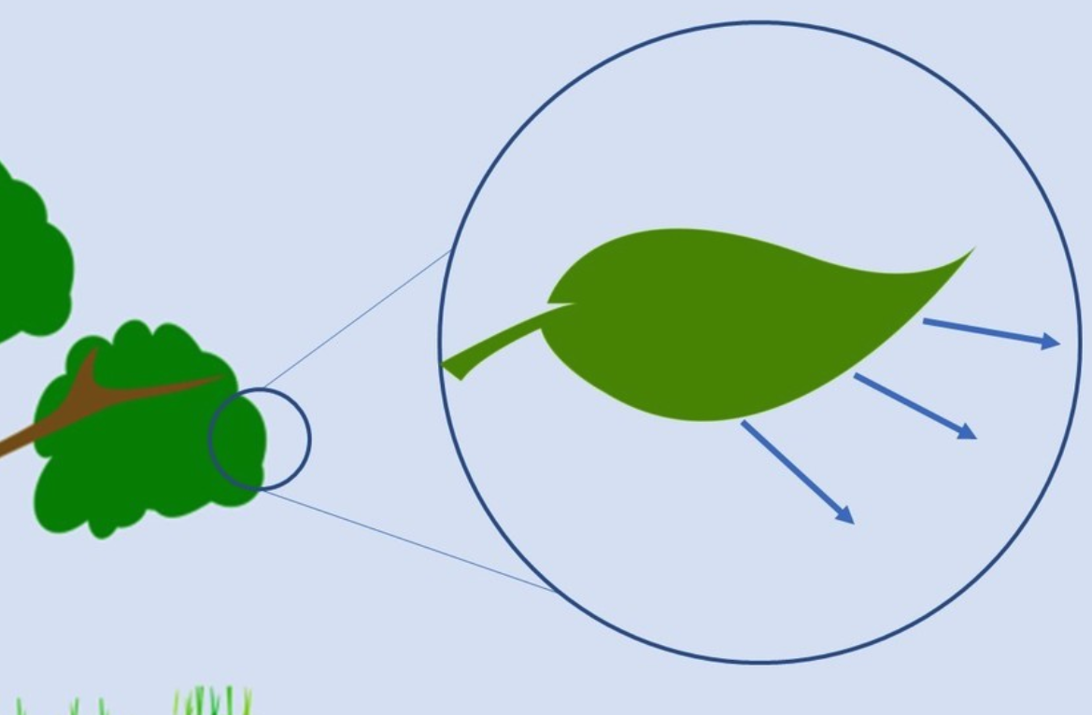
Do living things need different things to survive?
YEAR 3
Term 5
Plants – life cycles
Key Vocabulary
position
sundial clockwise transparent, opaque
light
shadow
mirror reflection reflective
solid
surfaces
absence
protect
Key Facts
There are tiny strands on roots which absorb the water and nutrients from the soil. These are called root hairs.
The xylem and phloem are a bit like veins – they go right from the roots, through the stem, to leaves. They transport water, food and nutrients.
Water escapes from the leaves, which forces the plant to suck more water up via the xylem to replace what it has lost. This is called transpiration.
The petal is bright and pretty to attract insects.
The anther makes pollen and is held up by the filament.
The stigma is sticky to stop the pollen dropping, and this sits on a tall style to make sure the insect can find it.
root hairs
xylem and phloem
transpiration
Ahmed Mumin Warfa
Warfa is a Somali scientist specializing in botany, who with his colleague Mats Thulin discovered a new type of cyclamen flower, the newest species to be described.

