Slide 1

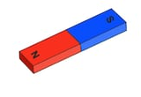
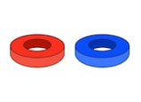
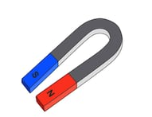
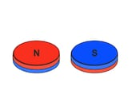

YEAR 4
Term 1
Forces and Magnets
What can magnets do?
Key
Vocabulary:
attract
repel
compass
pole
North
south
magnetic field
push
pull
gravity
surface
friction
lodestone
magnetic needle
pendulum
Key Facts:
A permanent magnet produces a magnetic field around it that enables it to stick to some types of metal, like iron.
Aluminium and copper are examples of metals which won’t stick to a magnet.
Some items can be magnetised by stoking a magnet along them in one direction. This can be useful for things like magnetising a screwdriver.
The Earth is a giant magnet, with a North and South Pole. It is magnetic because of the large amount of iron-rich molten rocks under its surface. The Earth’s magnetic field stretches into space.
A compass works because it’s north end is drawn to align with the Earth’s magnetic field. A compass has helped people navigate for many years.
Key Scientists:
Pierre Curie – He discovered that all magnetic materials sharply lose their magnetic properties when heated to a specific temperature. This was later called the ‘Curie Point’.
bar magnet
ring magnet
types of magnet
disc magnet
horseshoe magnet
Remember, with magnets, opposites attract. If a North Pole is next to a South Pole, these are attracted to each other and will stick together.
If magnetic poles are placed North to North or South to South, they are not attracted and will repel each other.
attraction
repulsion

