Slide 1
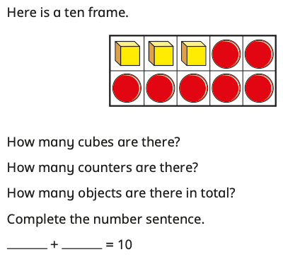
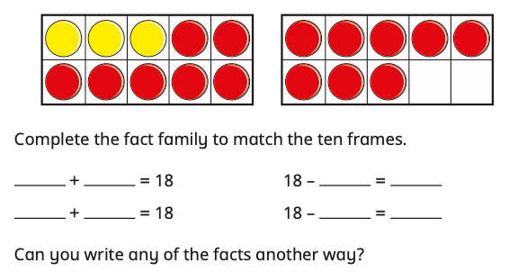
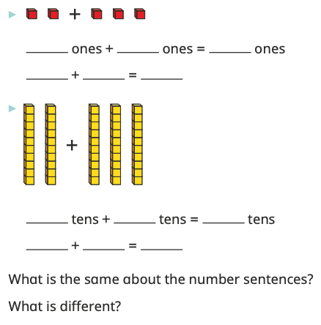
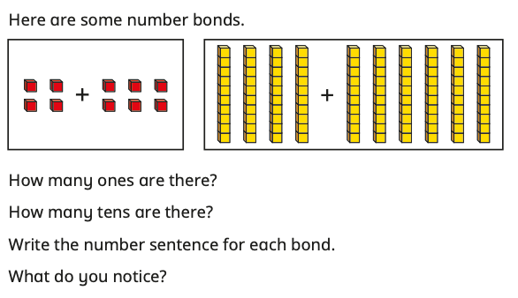
YEAR 2
Block 2
Maths – Addition and Subtraction
Small Steps:
Bonds to 10
Fact families – addition and subtraction bonds within 20
Related facts
Bonds to 100 (tens)
Add and subtract 1s
Add by making 10
Add three 1-digit numbers
Add to the next 10
Add across a 10
Subtract across 10
Subtract from a 10
Subtract a 1-digit number from a 2-digit number (across 10)
10 more, 10 less
Add and subtract 10s
Add two 2-digit numbers (not across a 10)
Add two 2-digit numbers (across a 10)
Key
Vocabulary:
add
subtract
number bonds
tens
ones
to 10
to 100
equal to
Key Questions:
How many _________ have you got?
How many more do you need to make 10?
What is the bond to 10 for _________?
What number are you starting with?
What do you need to add to make 10?
If 4 + 5 = 9, what is the missing number in 14 + ___ = 19? How do you know?
If 2 ones plus 3 ones is equal to 5 ones, what is 2 tens plus 3 tens?
What is the same about the number sentences? What is different?
How many tens are there?
How many more do you need to make 100?
If 4 + 6 = 10, what is the missing number in 40 + ___ = 100?
Stem Sentences:
If I have _________ counters, I need to add _________ more counters to make 10
____ ones + ____ ones = ____ ones,
so ____ tens + ____ tens = ____ tens.
This means that ____ + ____ = ____
If ____ ones + ____ ones = ten,
then ____ tens + ____ tens = 100

Slide 2
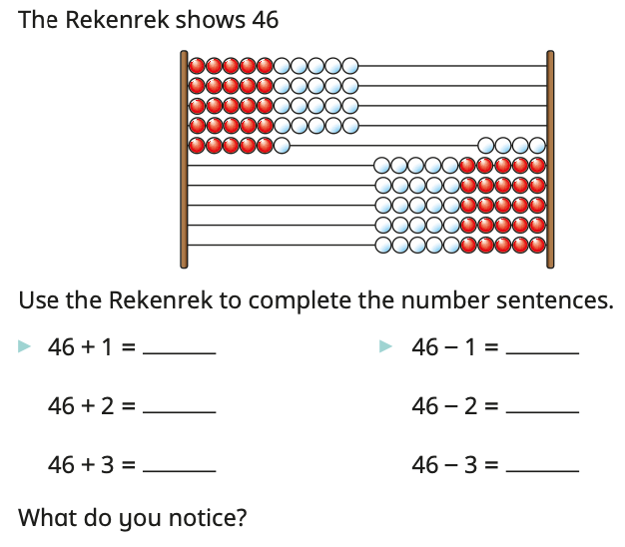
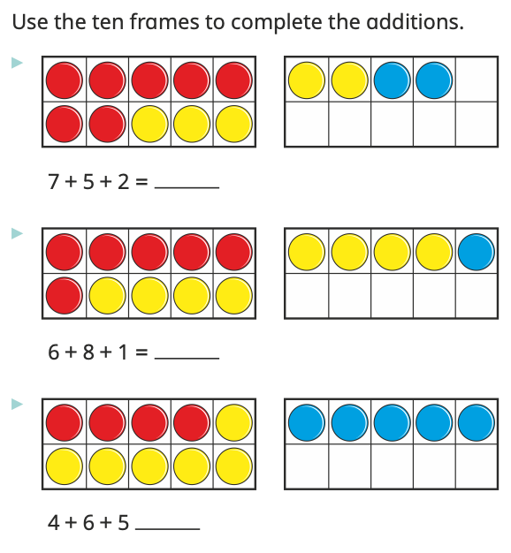
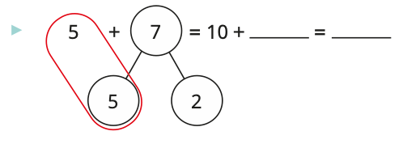
YEAR 2
Block 2
Maths – Addition and Subtraction
Small Steps:
Bonds to 10
Fact families – addition and subtraction bonds within 20
Related facts
Bonds to 100 (tens)
Add and subtract 1s
Add by making 10
Add three 1-digit numbers
Add to the next 10
Add across a 10
Subtract across 10
Subtract from a 10
Subtract a 1-digit number from a 2-digit number (across 10)
10 more, 10 less
Add and subtract 10s
Add two 2-digit numbers (not across a 10)
Add two 2-digit numbers (across a 10)
Key
Vocabulary:
add
subtract
number bonds
tens
ones
partition
to 10
to 100
equal to
Key Questions:
How many ones are there in _________?
How many ones do you need to add/subtract?
What is ____ ones + ____ ones?
What is ____ + ____?
What happens to the tens? What happens to the ones?
What is the bond to 10 for ____?
What can you partition _______ into?
How many more do you need to add to 10?
Why does partitioning ____ into ____ and ____ help with this question?
Does it matter what order you add the numbers in?
Can you see any numbers in the calculation?
What is the most efficient way to complete the calculation?
Stem Sentences:
_______ can be partitioned into ______ and ______
____ ones + ____ ones = ____ ones,
so ____ tens + ____ tens = ____ tens.
This means that ____ + ____ = ____
If ____ ones + ____ ones = ten,
then ____ tens + ____ tens = 100

Slide 3
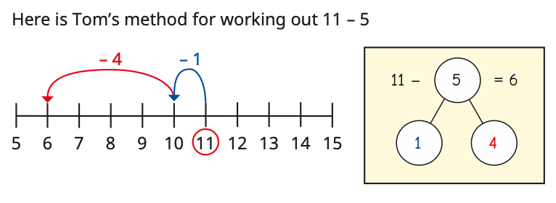
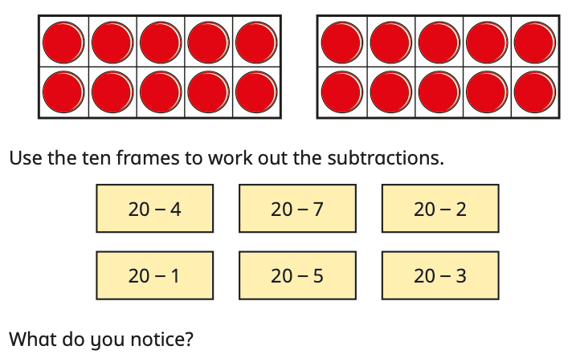
YEAR 2
Block 2
Maths – Addition and Subtraction
Small Steps:
Bonds to 10
Fact families – addition and subtraction bonds within 20
Related facts
Bonds to 100 (tens)
Add and subtract 1s
Add by making 10
Add three 1-digit numbers
Add to the next 10
Add across a 10
Subtract across 10
Subtract from a 10
Subtract a 1-digit number from a 2-digit number (across 10)
10 more, 10 less
Add and subtract 10s
Add two 2-digit numbers (not across a 10)
Add two 2-digit numbers (across a 10)
Key
Vocabulary:
add
subtract
number bonds
tens
ones
to 10
to 100
equal to
multiple of
partition
Key Questions:
What numbers do you need to add together?
How many tens are there in _______?
What is the multiple of 10 after _______?
How many ones are there in _______?
What is the bond to 10 for _______?
What can you partition _______ into?
How many do you need to takeaway?
How many do you need to subtract to get to 10?
How many more do you need to subtract?
If you know that 4 + 6 = 10, what is 50 - 6?
What do you notice about the tens? What do you notice about the ones?
Stem Sentences:
I need to add ____ to get to the next 10
____ + ____ = ____
I need to add ____ more.
So, ____ + ____ = ____
I need to subtract ____ to get to 10
I can partition ____ into ____ and ____
____ + ____ = ____
I need to subtract ____ more.
____ less than ____ is ____

Slide 4
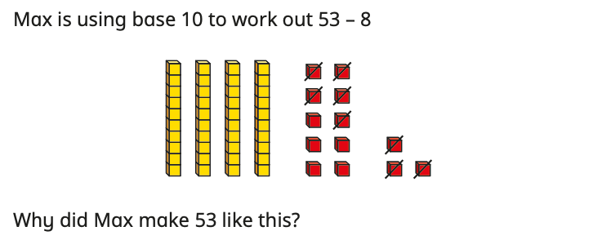
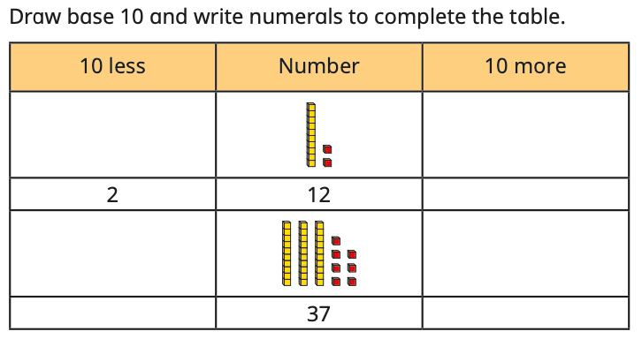
YEAR 2
Block 2
Maths – Addition and Subtraction
Small Steps:
Bonds to 10
Fact families – addition and subtraction bonds within 20
Related facts
Bonds to 100 (tens)
Add and subtract 1s
Add by making 10
Add three 1-digit numbers
Add to the next 10
Add across a 10
Subtract across 10
Subtract from a 10
Subtract a 1-digit number from a 2-digit number (across 10)
10 more, 10 less
Add and subtract 10s
Add two 2-digit numbers (not across a 10)
Add two 2-digit numbers (across a 10)
Key
Vocabulary:
add
subtract
number bonds
tens
ones
to 10
equal to
partition
multiple of 10
count on
count back
Key Questions:
How many do you start with?
How many do you need to take away?
What can you partition ____ into?
How many do you need to subtract to get to the previous 10? How many more do you need to subtract?
When you count on/count back 10, what do you get?
Count on/count back another 10, what do you get?
What do you notice about the number of tens?
What do you notice about the number of ones?
What do you notice about the position of the numbers on the hundred square?
Stem Sentences:
The previous multiple of 10 is ____
____ = ____ + ____, so
____ - ____ = ____
I need to subtract ____ and then subtract another ____
____ has ____ tens and ____ ones
10 more than ____ is ____
10 less than ____ is ____
____ has ____ tens
To add/subtract ____, I need to add/subtract 10 ____ times.

Slide 5
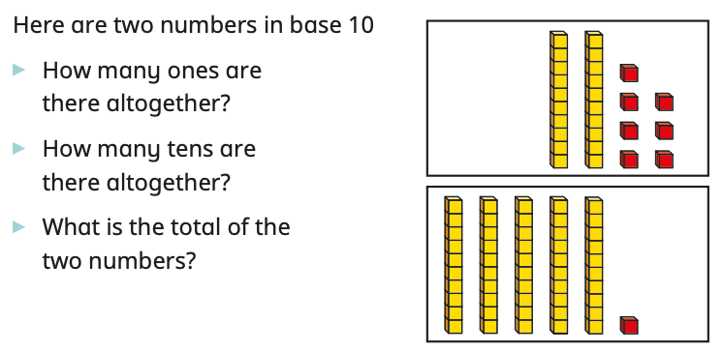
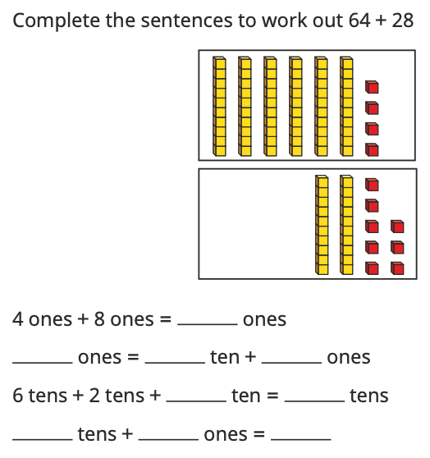
YEAR 2
Block 2
Maths – Addition and Subtraction
Small Steps:
Bonds to 10
Fact families – addition and subtraction bonds within 20
Related facts
Bonds to 100 (tens)
Add and subtract 1s
Add by making 10
Add three 1-digit numbers
Add to the next 10
Add across a 10
Subtract across 10
Subtract from a 10
Subtract a 1-digit number from a 2-digit number (across 10)
10 more, 10 less
Add and subtract 10s
Add two 2-digit numbers (not across a 10)
Add two 2-digit numbers (across a 10)
Key
Vocabulary:
add
subtract
number bonds
tens
ones
to 10
equal to
partition
exchange
Key Questions:
What numbers are you adding together?
How many ones are there in each number?
How many ones are there altogether?
How many tens are there in each number?
How many tens are there altogether?
Can you make an exchange? Why?
When adding, did you include the ten from your exchange?
Stem Sentences:
____ ones + ____ ones = ____ ones
____ tens + ____ tens = ____ tens
____ has ____ tens and ____ ones.
There are ____ ones altogether. There are ____ tens altogether. ____ tens and ____ ones is ____.
There are ____ ones, so I do/do not need to make an exchange.

