Slide 1

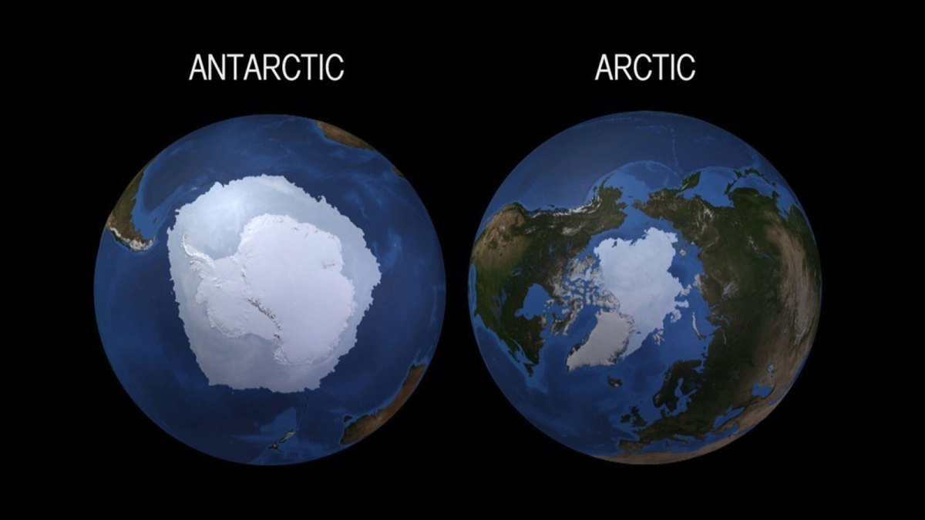
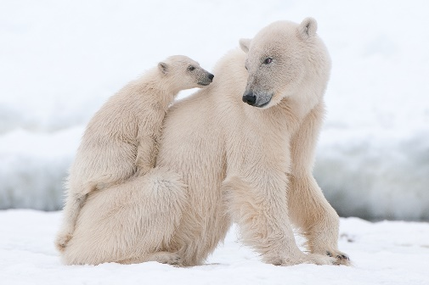
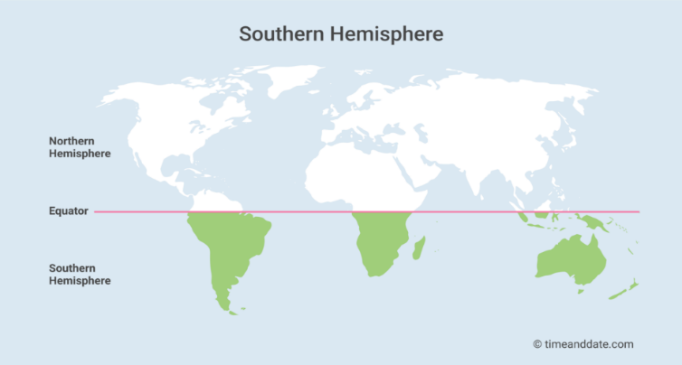
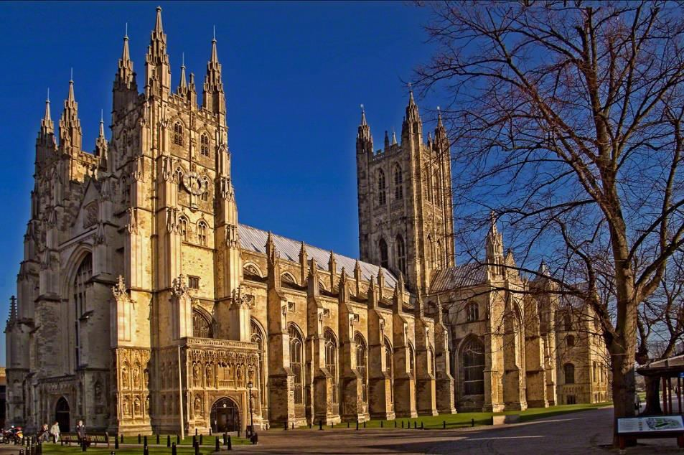
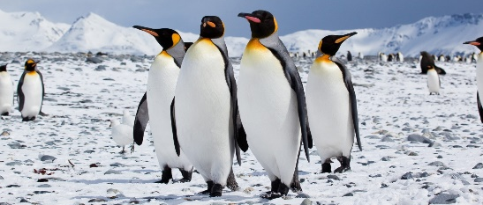
How is global warming affecting the ice caps?
YEAR 4
Term 1/2
Poles Apart - geography
Key Vocabulary
global warming
greenhouse gases
temperature
polar
Arctic
Antarctic
desert
ecosystem
iceberg
glacier
blizzard
ice floe
ice cap
biome
hemisphere
tundra
permafrost
North and South Pole
Polar biome
The North Pole is the Arctic (northern hemisphere) and the South Pole is the Antarctic (southern hemisphere).
Both poles are covered in ice caps
The Arctic and Antarctic circles receive less warmth fro the sun because they are further away.
The Antarctic is a landmass.
Much of the Arctic is frozen ice on the ocean.
In the winter there is very little daylight at the poles
The polar biome is made up of polar deserts and tundra.
The polar regions are classified as deserts as they have less than 250mm rainfall (snow) each year.
There is little vegetation at the poles as the soil is mostly permafrost and there is little water to support plant life.
Average temperatures are -4ºC, but can go down to -80ºC
Ice caps are melting at a much higher rate than in the past, due to global warming.
Polar animals
Polar bears are only found at the North Pole.
Penguins are only found at the South Pole.
Polar animals have many adaptations to enable them to live in these environments, but global warming is leading to them having difficulty in finding food supplies as the ice is melting.

