Slide 1
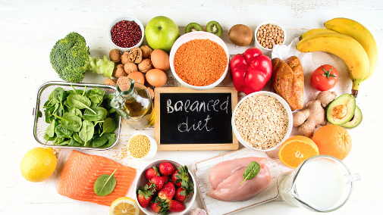
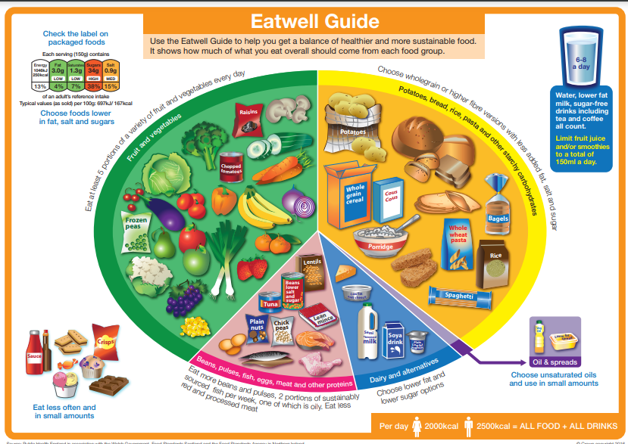
What can we do to have a healthier future?
YEAR 3
Term 1/2
We are healthy
Key Vocabulary
exercise
calories
energy
fat
protein
fibre
carbohydrate
balanced-diet
obesity
overweight
Being healthy is about being physically and mentally healthy
To be healthy you can:
Exercise regularly
Eat a balanced diet
Have a happy and positive attitude
Have a good sleep schedule
The Eatwell guide suggests how we should break down our food choices in the healthiest way. We should mostly eat fruit and vegetables and wholegrains.
Obesity is a serious condition caused by lack of exercise and over-eating.
All food contains calories – we need calories to give us energy, but too many calories are stored as fat
We need to avoid eating too many fast food items and processed foods as they are high in fat, sugar and salt

