Slide 1
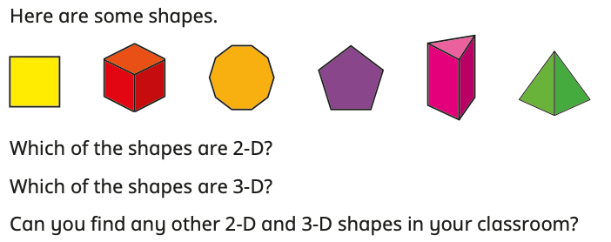
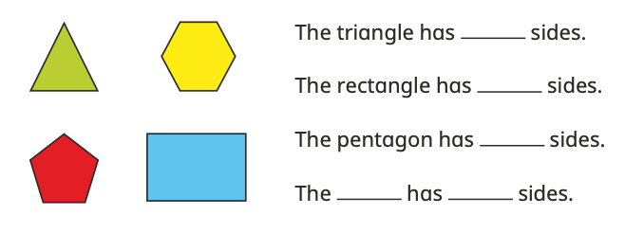
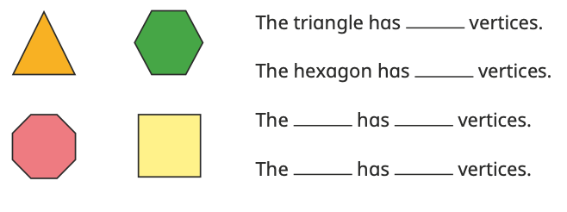
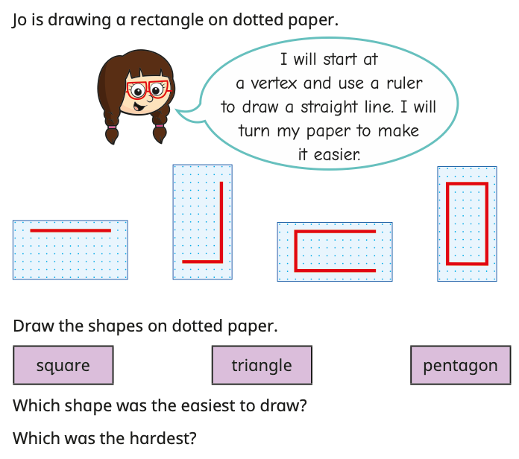
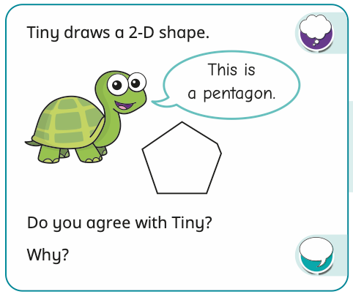
YEAR 2
Block 3
Maths – Geometry
Small Steps:
Recognise 2D and 3D shapes
Count sides on 2D shapes
Count vertices on 2D shapes
Draw 2D shapes
Lines of symmetry on shapes
Use lines of symmetry to complete shapes
Sort 2D shapes
Count faces on 3D shapes
Count edges on 3D shapes
Count vertices on 3D shapes
Sort 3D shapes
Make patterns with 2D and 3D shapes
Key Questions:
What is the difference between a 2D and a 3D shape?
What is the name of this shape? How do you know?
Does a ________ always looks the same? Can you think of some examples?
What 2D shapes can you see on this 3D shape?
Which shape is the odd one out? How do you know?
What is a side?
How many sides does a _________ have?
What is the name of a shape with _________ sides?
What is a vertex? How can you count them accurately?
How many vertices does a _________ have?
How many sides does this shape have? How many vertices does it have? What do you notice?
How can you accurately draw a _________? Is there more than one way to draw a _________?
Key
Vocabulary:
2D
3D
side
vertex
vertices
ruler
circle
triangle
quadrilateral
square
rectangle
pentagon
hexagon
octagon
sphere
cone
cuboid
cube
pyramid
Stem Sentences:
This shape is a _________ because …
A _________ is a 2D shape.
A _________ is a 3D shape.
A _________ has _________ straight sides.
I know I have counted all the sides because …
A _________ has _________ vertices and _________ sides.
The number of vertices a shape has is _________ to the number of sides.
To draw a _________, I need to draw _________ sides and _________ vertices.

Slide 2
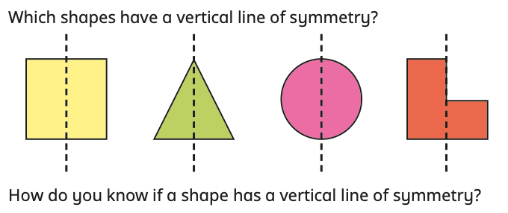
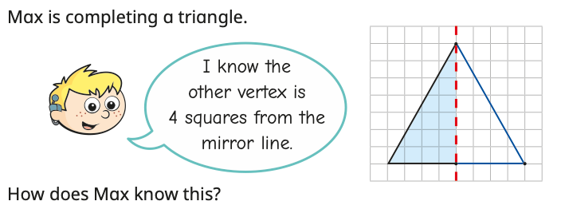
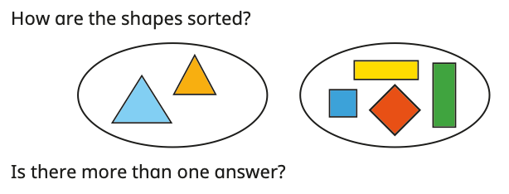
YEAR 2
Block 3
Maths – Geometry
Small Steps:
Recognise 2D and 3D shapes
Count sides on 2D shapes
Count vertices on 2D shapes
Draw 2D shapes
Lines of symmetry on shapes
Use lines of symmetry to complete shapes
Sort 2D shapes
Count faces on 3D shapes
Count edges on 3D shapes
Count vertices on 3D shapes
Sort 3D shapes
Make patterns with 2D and 3D shapes
Key Questions:
What does “symmetrical” mean?
How do you know if a shape is symmetrical?
How can you use a mirror to help you?
Is the shape the same on both sides?
How can you be accurate when drawing a vertical line of symmetry?
How could marking the vertices and joining them up help you find the line of symmetry?
What mistakes do you think you might make when completing this shape?
How have you sorted the shapes?
How do you know this shape is in the correct group?
Are there any other ways to sort the shapes?
What other shape could go in this group?
What shape could not go in this group?
Key
Vocabulary:
2D
3D
side
vertex
vertices
ruler
symmetrical
symmetry
vertical
sort
group
Stem Sentences:
This shape is symmetrical because...
I know that this is a line of symmetry because ...
A mirror can help me find lines of symmetry because …
The vertex is ______ squares away from the mirror line. I need to count ______ squares away from the mirror line on the opposite side.
I put the ______ in this group because …
The shapes could have been sorted into ______ and ______, because …
______ belongs/does not belong in this group because …

Slide 3
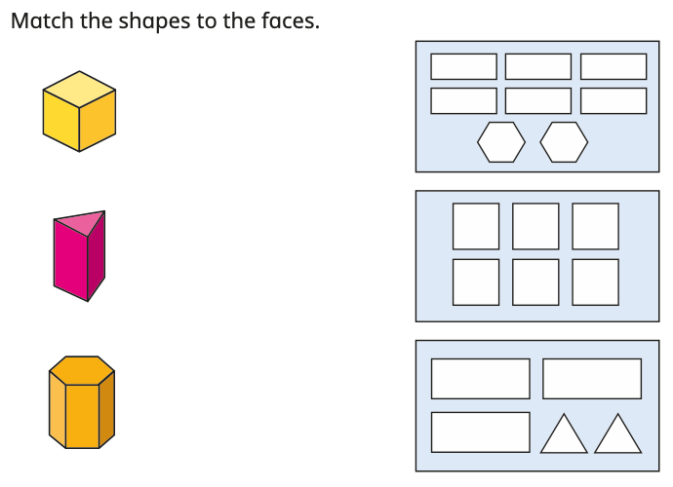
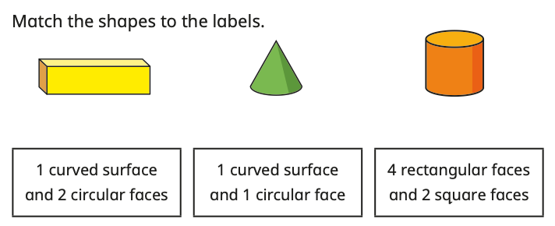
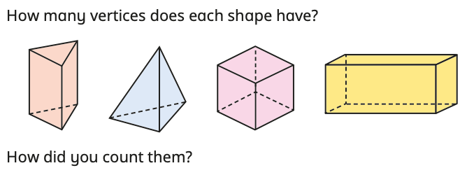
YEAR 2
Block 3
Maths – Geometry
Small Steps:
Recognise 2D and 3D shapes
Count sides on 2D shapes
Count vertices on 2D shapes
Draw 2D shapes
Lines of symmetry on shapes
Use lines of symmetry to complete shapes
Sort 2D shapes
Count faces on 3D shapes
Count edges on 3D shapes
Count vertices on 3D shapes
Sort 3D shapes
Make patterns with 2D and 3D shapes
Key
Vocabulary:
2D
3D
vertex
vertices
face
curved surface
edge
more than
less than
Key Questions:
What is a face?
What is a curved surface?
What is the difference between a face and a curved surface?
How many faces does a ______ have?
What is an edge?
How is an edge different from a face?
How many edges does a ______ have?
What is a vertex? What are vertices?
How is a vertex different from a face? How is it different from an edge?
How many vertices does a ______ have?
Stem Sentences:
A ______ has ______ faces.
A ______ has ______ faces and ______ curved edges.
The 2D shapes that make up the faces of a ______ are …
A ______ has ______ edges
A ______ has ______ faces and ______ edges.
A ______ has fewer/more edges than a ______
A ______ has ______ vertices
A ______ has ______ vertices, ______ faces and ______ edges.

Slide 4
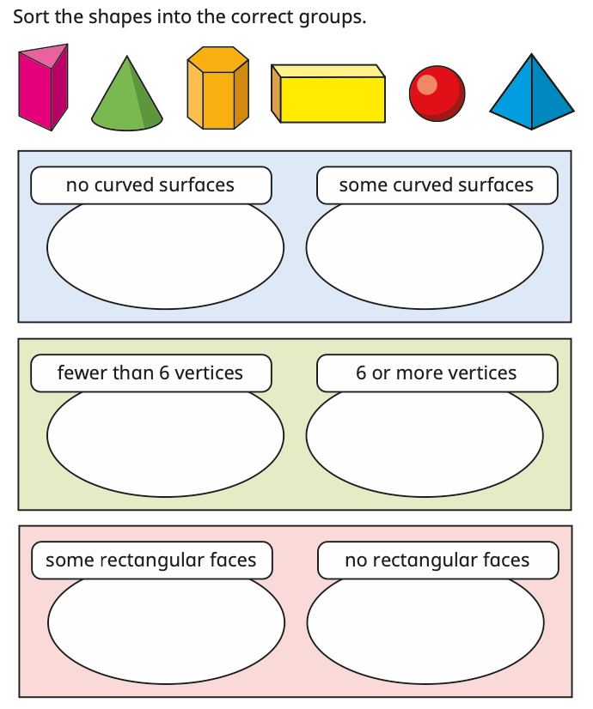
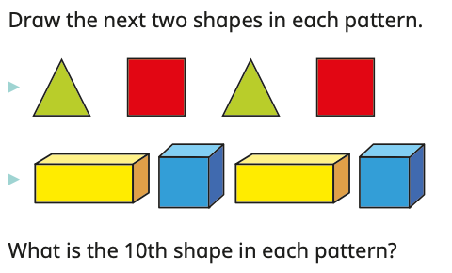
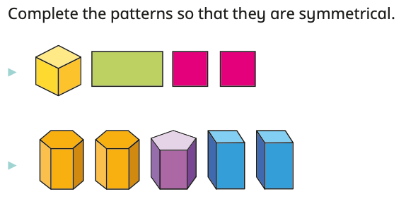
YEAR 2
Block 3
Maths – Geometry
Small Steps:
Recognise 2D and 3D shapes
Count sides on 2D shapes
Count vertices on 2D shapes
Draw 2D shapes
Lines of symmetry on shapes
Use lines of symmetry to complete shapes
Sort 2D shapes
Count faces on 3D shapes
Count edges on 3D shapes
Count vertices on 3D shapes
Sort 3D shapes
Make patterns with 2D and 3D shapes
Key
Vocabulary:
2D
3D
sort
group
vertex
vertices
face
curved surface
side
edge
symmetrical
symmetry
repeating
Key Questions:
How can you sort these shapes?
Which group does a ______ go into?
How do you know this shape is in the correct group?
Which shape is the odd one out?
What shapes can you see in the pattern?
Which shapes are repeating?
What would be the next shape in the pattern? What would be the shape after that? What would be the 10th shape?
Is the pattern repeating or symmetrical?
How do you know that the next shape is not a ______?
Stem Sentences:
______ is the odd one out because …
My two groups are ______ and ______. A ______ belongs in ______
I have sorted the shapes by …
The next shape will be a ______, because …
The shapes that are repeating are ______, ______, …
I know that the 10th shape in the pattern will be a ______, because …

