Slide 1
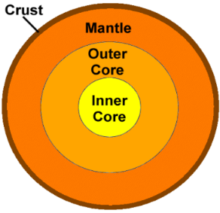
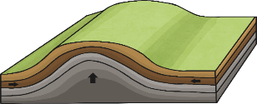
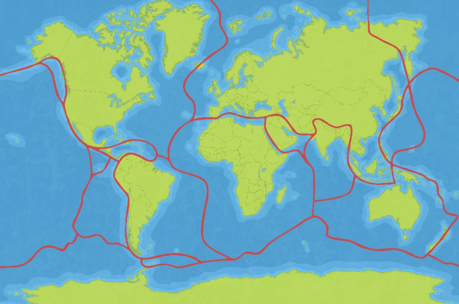
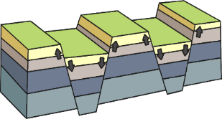
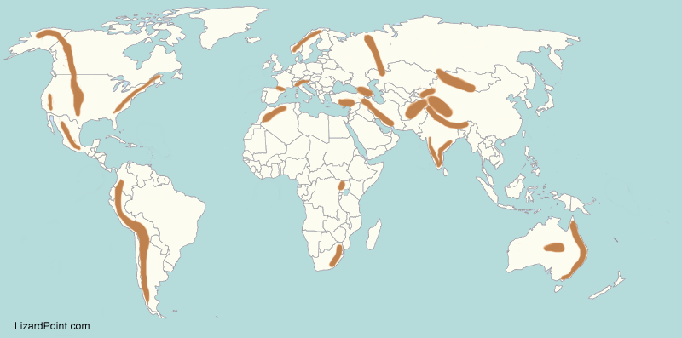
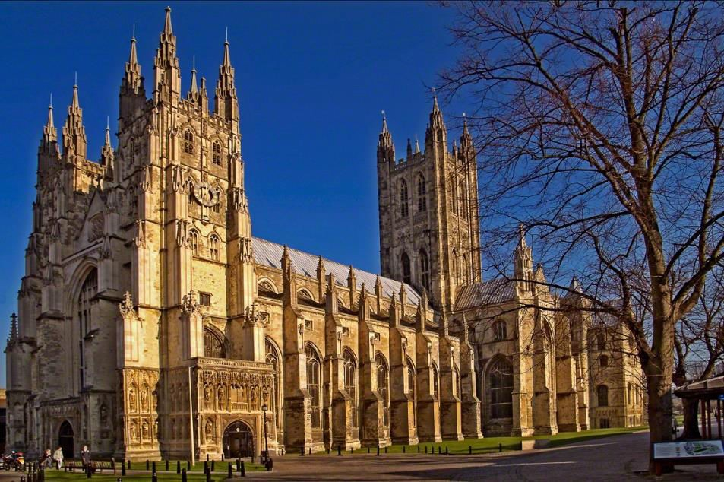
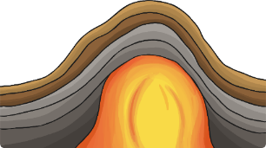
YEAR 3
Term 5/6
We are healthy - geography
How are mountains created?
Key Vocabulary
location
hills
mountains
crevasse
dormant
erosion
eruption
lava
magma
peak
range
ravine
slope
summit
valley
volcano
Locations of mountain ranges
How mountains are formed
Mountains are called when plates meet each other
The “Ring of Fire” is an area in the Pacific Ocean with the most volcanoes.
A volcano is an opening in the Earth’s crust that allows magma to escape.
The highest mountain ranges in the UK are the Grampians, Snowdonia, Cambrian Mountains and the Pennines
The highest mountain ranges in Europe are the Alps
The world’s longest mountain range is the Andes in South America
The highest world mountain ranges are the Himalayas, when Mount Everest is situated – the highest mountain in the world.
The outer layer of the earth is called the crust. It is between 5km and 70km thick and floats on the mantle
The crust is made up of tectonic plates which fit together like a puzzle covering the earth.
Fold mountains occur when plates collide and the edges of the plates are pushed together.
Fault block mountains occur when cracks in the earth’s surface open up and rock is pushed up.
Dome mountains are formed when magma is forced up between the crust and the mantle, but doesn’t ever flow out.

