Slide 1
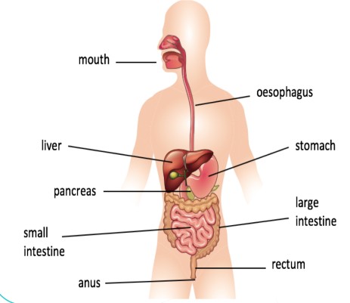
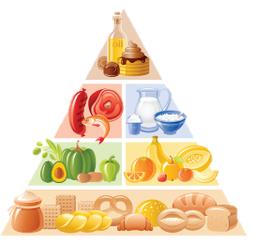
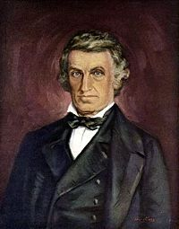
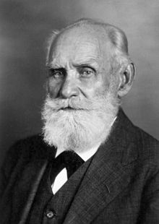
What do our bodies do with the food we eat?
YEAR 3
Term 2
Animals Including Humans – Food and Digestion
Key Vocabulary
saliva
glands
taste buds digest
incisors
canines
molars
small intestine large intestine stomach appendix nutrient vitamins minerals
Key Facts
Most of our protein comes from meat, fish, eggs and nuts.
Fruit and vegetables are full of the vitamins we need to be healthy.
A food chain is vital for nature to survive
We are ‘consumers’ as we eat food to make the energy we need.
In the UK, 1.9 million tonnes of food is wasted each year!
The digestive process begins in the mouth with our teeth. Saliva then helps to break down our food
Nutrients provide nourishment to the body
Adelle Davis
William Beaumont
Ivan Pavlov
Beaumont was a surgeon in the US army. He carried out extensive research on human digestion.
Pavlov was a physiologist who studied the digestive system. He is most famous for an experiment where he got dogs to salivate on the ringing of a bell.

