Slide 1
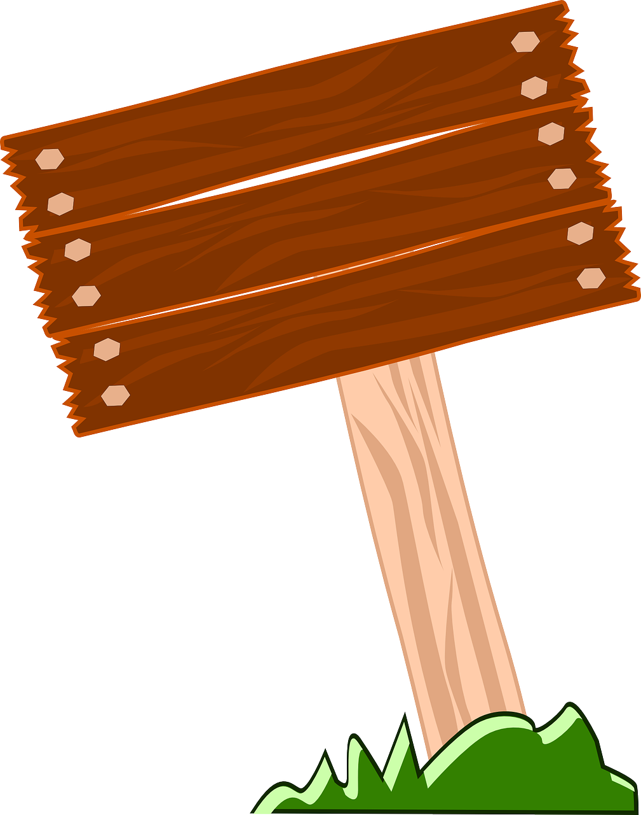
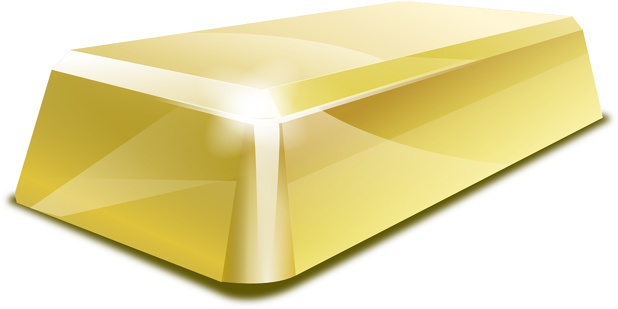
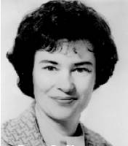
YEAR 1
Term 1
Exploring Everyday Materials
What are things made from?
Key Vocabulary
translucent
opaque
light
flexible
float
sink
materials
rigid
translucent
clear
magnet
metal
plastic
paper
man-made
natural
recycle
bendy
soft
hard
magnetic
natural
brittle
elastic
Key Facts
Materials are chosen carefully for a specific task
Materials are tested a lot before being used to make something
Most materials we buy can be recycled or reused
Magnets are only attracted to certain metals
Magnets have a north and south pole
Some materials are natural and some are man-made
We describe a material by talking about its properties
Plastic is very versatile and can be moulded into different shapes
Iron is a magnetic metal, but aluminium is not magnetic.
Glass is made by heating up sand!
You can find hardwoods like oak and softwoods like pine.
Recycling is very important to help our planet.
Gold is sometimes found by miners blowing up holes in the ground!
Key Scientists
Patsy Sherman was an American scientist. She invented the product “Scotchgard” which is a stain and water repellent

