Slide 1
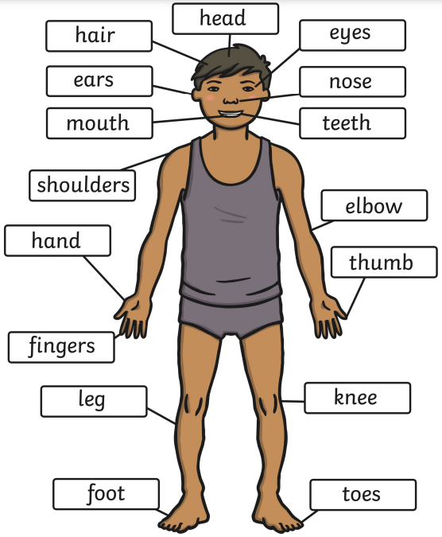
What are bodies and what can they do?
YEAR 1
Term 3
Animals Including Humans – About Me
Key Vocabulary
senses
sight
taste
touch
hearing
smell
nose
head
organs
torso
arms
legs
baby
food
grow
hair
teeth
exercise cleanliness
heathy
food
rest
Key Facts
Exercise is important because it keeps us healthy. A healthy body makes us feel good.
It is important to keep clean by washing our hair and cleaning our teeth.
We need to sleep well because it gives us more energy the next day.
Babies grow into a child and then into an adult.
Bones make up our skeleton which holds our body together. There are 270 bones in the human body.
Our lungs help us to breathe.
When we exercise, our heart rate gets faster.
Humans have 5 senses. Our senses help us to enjoy the world, but also help to keep us safe

