Slide 1
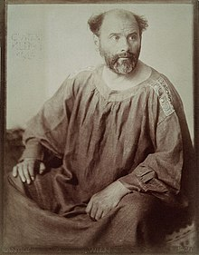
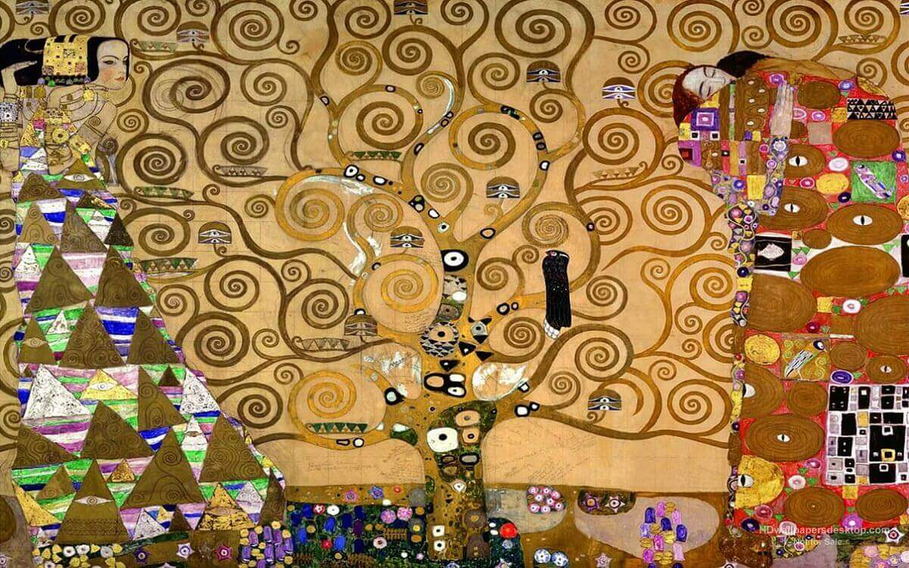
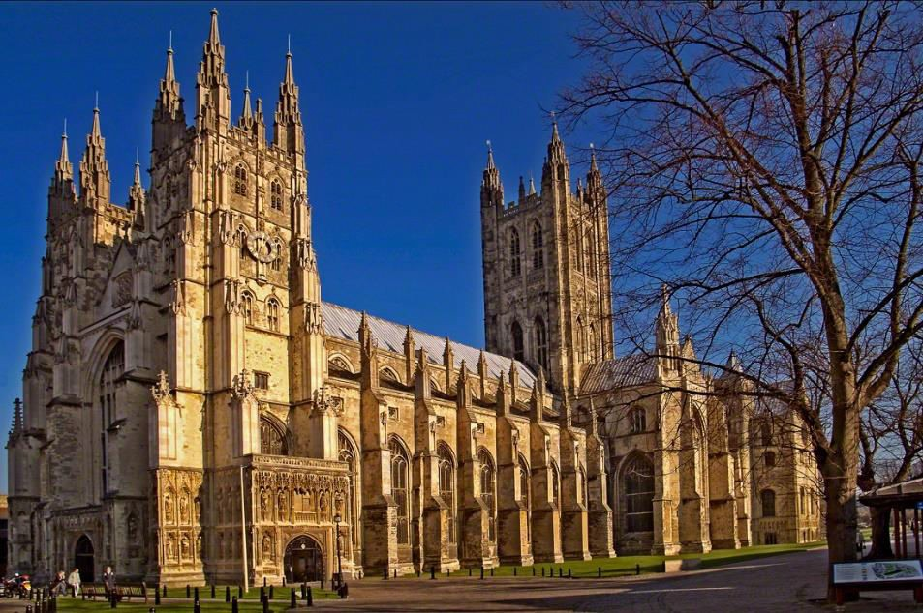
How so I mix primary colours to make other colours?
YEAR 1
Term 1
Gustav Klimt - art
Key Vocabulary
primary colours
collage
line
shape
pattern
spiral
swirl
pattern
Gustav Klimt 1862 - 1918
Klimt was an Austrian symbolist painter
He liked to use gold leaf in his paintings
The Tree of Life is Klimt’s only landscape painting using gold leaf
With its branches reaching for the sky, the tree of life roots into the earth beneath, creating the connection between heaven and earth
The swirls and spirals of the branches are said to represent the twists and turns of life
The women’s dresses are heavily patterned, but still include the spirals and swirls that are on the tree.

