Slide 1
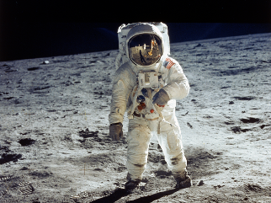
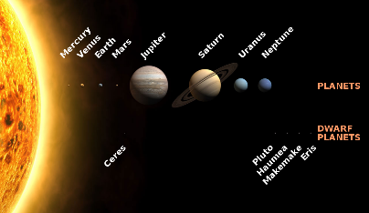
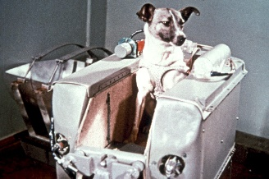
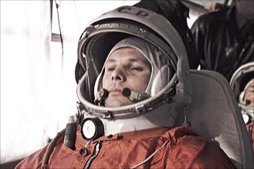
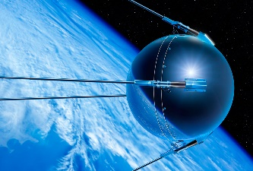
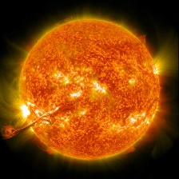
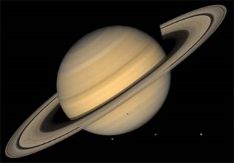
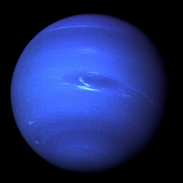
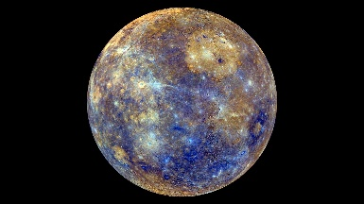
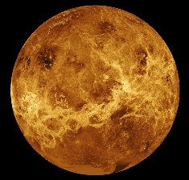
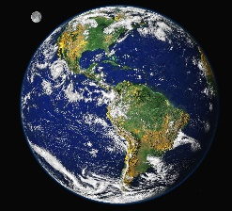
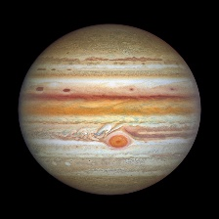
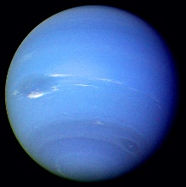
YEAR 2
Term 3/4
To Infinity and Beyond
Is there life somewhere in space?
Key Vocabulary
space
space race
spacecraft
rocket
Apollo 11
Sputnik
satellite
Earth
Mercury
Venus
Mars
Juptiter
Saturn
Uranus
Solar System
Milky Way
shuttle
telescope
universe
meteor
Comet
planet
History
Science
People have looked to the skies for generations, curious about what is out there
The Space Race 1955-1975, was a time when the USA and Russia competed to achieve space flight
The first animal in space were fruit flies, followed by a monkey
Laika, a dog, was the first animal to orbit the earth in a spacecraft
The first man in space was Russian Yuri Gagarin in 1961
The Americans launched their Apollo 11 space mission in 1969. They landed on the moon and completed a space walk.
The first satellite (Sputnik 1) was launched by the Russians in 1957. We now rely on satellites for helping us to predict the weather, to enhance TV signals and telephone communication and for the internet
There are 8 planets in the solar system that all orbit the sun: Earth, Mercury, Venus, Mars, Jupiter, Saturn, Uranus and Neptune
Pluto is a dwarf planet.
We can recall the order of the planets using the mnemonic: My Very Easy Method Just Speeds Up Naming Planets
Earth is a big place but within the solar system it is quite small. It would take 1.3 million planets the size of Earth to fill up the sun. Earth is a lot smaller than planets like Jupiter and Saturn.
The Solar System was formed 4.6 billion years ago from a cloud of gas and dust called the solar nebula.
The solar system is part of the Milky Way
There are at least 30 times more stars in The Milky Way than there are people on Earth.
The sun is 93 million miles from the Earth

