Slide 1
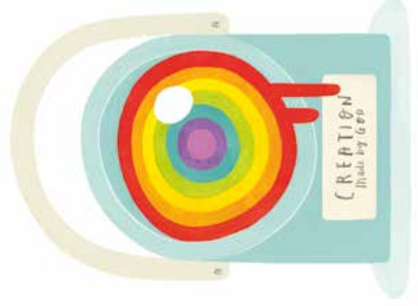
Who made the world?
YEAR 2
Term 1
Creation
Key Vocabulary
God
universe
creator
sustainer
Genesis
Matthew
creation
appreciating
transporting
Knowledge Building Blocks
Key Bible Stories
Genesis 1
This is a story told by Jewish and Christian people
Creation is the start of the Big Story of the Bible
On the first day God created light
On the second day God created the sky
On the third day dry land, seas, plants and trees were created
On the fourth day the sun, moon and stars were created
On day five God created creatures that live in the sea and creatures that fly
On the sixth day animals that live on the land and finally humans, made in the image of God were created
On day seven, God rested – this seventh day became a holy day
God created the universe.
The Earth and everything in it are important to God.
God has a unique relationship with human beings as their Creator and Sustainer.
Humans should care for the world because it belongs to God.

