Slide 1
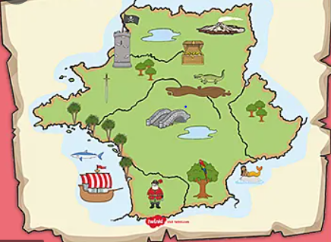
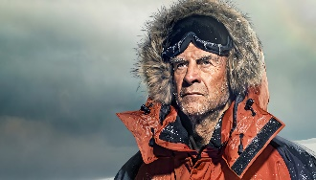
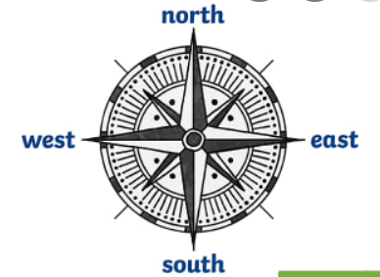
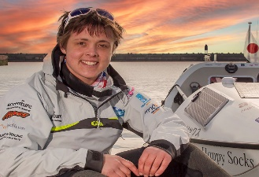
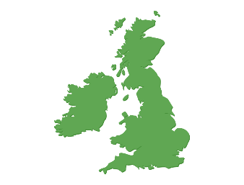
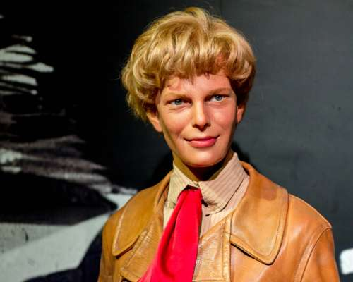
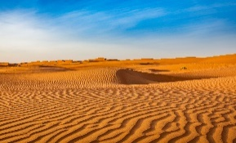
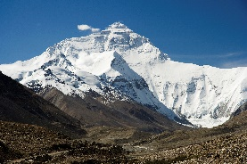
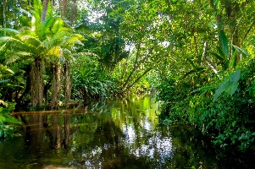
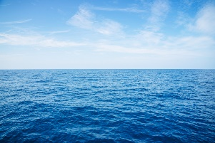
We are Adventurers
Where can our journey take us?
YEAR 1
Term 1
Key Vocabulary
adventure
journey
map
travel
island
map
symbols
directions
left
right
compass
north
south
east
west
UK
Great Britain
Artic
desert
sea
rainforest
mountain
forest
North Pole
South Pole
Geography
A map is used to record what a place looks like from above. They can help you to find where you are going.
A compass can be used with a map so that the map is used the right way up.
A compass has 4 main directions, north, south, east and west.
Maps have symbols on them to represent things like roads, forests, rivers
An island is an area of land surrounded by water.
The UK is an island
The world is made up of different types of terrain including desert, mountains, seas, and rainforest
History
For generations people have been exploring the world to find out what is there.
Explorers have made incredible journeys and have had some very tough experiences.
Ranulf Fiennes has led 30 expeditions to the North and South Poles. He has lost fingers and toes to frostbite.
Sarah Outen is a sailor. She is the youngest person to row solo across an ocean.
Amelia Earhart was the first woman to fly solo across the Atlantic Ocean. She later mysteriously disappeared.

