Slide 1
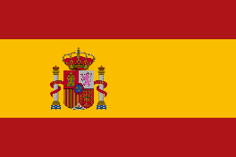
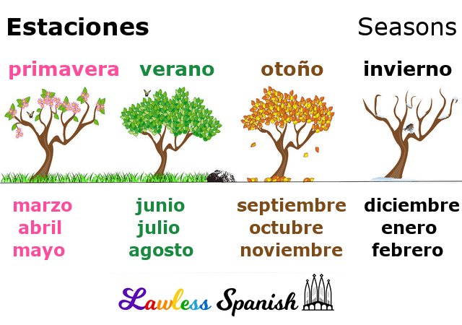
YEAR 3
Stage 1
Autumn 2
Spanish
The Calendar and Celebrations - Months
Knowledge Building Blocks:
I can say some colours linked to Autumn.
I can learn some months of the year.
I can understand, say and try to write some months of the year.
Key Vocabulary:
Noun Bank
enero- January
febrero- February
marzo- March
abril- April
mayo- May
junio- June
julio- July
agosto - August
septiembre - September
octubre - October
noviembre - November
diciembre – December
Fact Bank
Lots of the months in Spanish look very similar to English spelling if the months. There are no capital letters in Spanish at the start of the month.
Sound spelling
“j”
“i”
“ciem”
Question and Answer Bank
¿Cuando es tu cumpleaños?- When is your birthday?
Grammar
When words are the same in two languages we call them cognates and when they look very similar we call them semi-cognates.

Slide 2
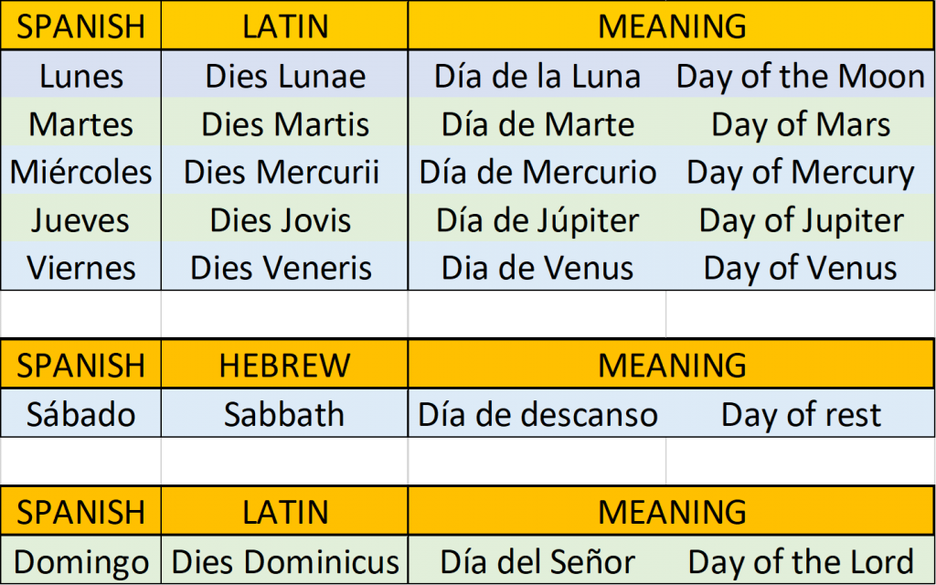
Spanish
The Calendar and Celebrations - Days
YEAR 3
Stage 1
Autumn 2
Knowledge Building Blocks:
I can understand and say some days of the week in Spanish.
I can remember and try to write some days of the week in Spanish.
Key Vocabulary:
Noun Bank
lunes - Monday
martes- Tuesday
míercoles - Wednesday
jueves- Thursday
viernes- Friday
sábado - Saturday
domingo- Sunday
Grammar
When you ask a question in Spanish you can turn a sentence into a question by raising the pitch of your voice at the end of the question.
Sound spelling
“j”
“v”
Fact Bank
Some of the Spanish days of the week are named after the planets e.g. martes (Mars)”.
Question and Answer Bank
¿Qué día es hoy?- What day is it today?

