Slide 1
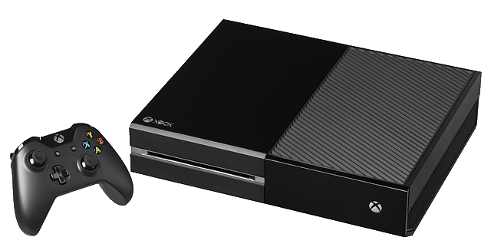
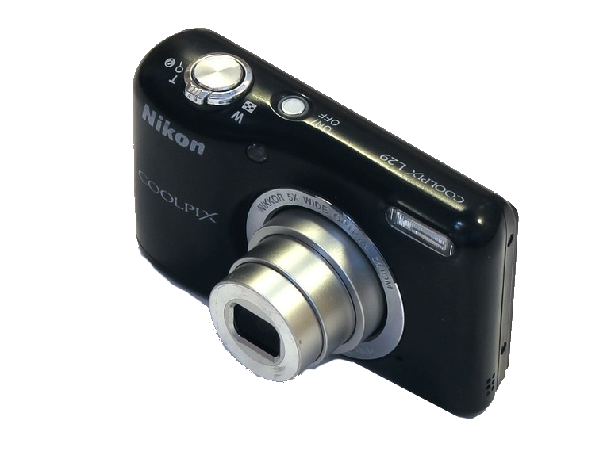
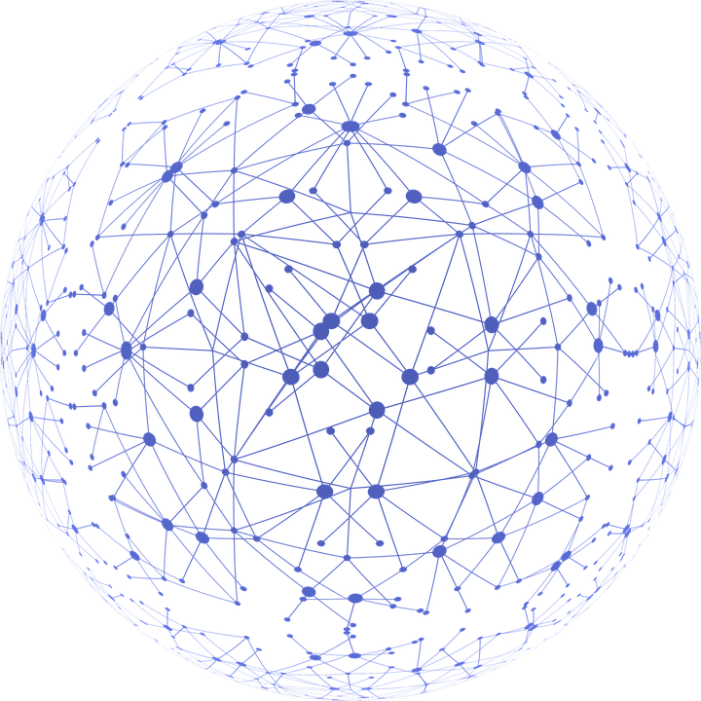
YEAR 3
Term 1
Computing Systems and Networks – Connecting Computers
Process
Key
Vocabulary:
input
process
output
device
computer system
digital device
network
components
switch
server
wireless access
connections
infrastructure
Knowledge Building Blocks:
To describe what an input is.
To explain that a process acts on the inputs.
To identify input and output devices.
To explain that an output is produced by the process.
To explain that a computer system accepts an input and processes it to produce an output.
To explain how computer systems can change the way that we work.
To identify how changing the process can affect the output.
To recognise that a digital device is made up of several parts.
To recognise that computers can be connected to each other.
To identify how devices in a network are connected with one another.
To recognise that a network is made up of a number of components.
To explain how a computer network can be used to share information.
To explain the role of a switch, server, and wireless access point in a network.
To explain how information is passed through multiple connections.
To identify the benefits of computer networks.
To identify network devices around me.
To explain how networks can be connected to other networks.
Input
Output
When ‘H’ key pressed, display ‘H’
When ‘e’ key pressed,
display ‘e’
When...
Hello world
Digital Devices:
Networks:

