Slide 1
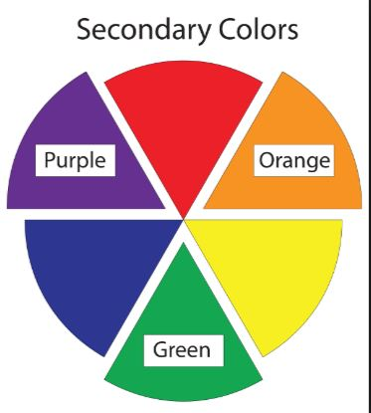
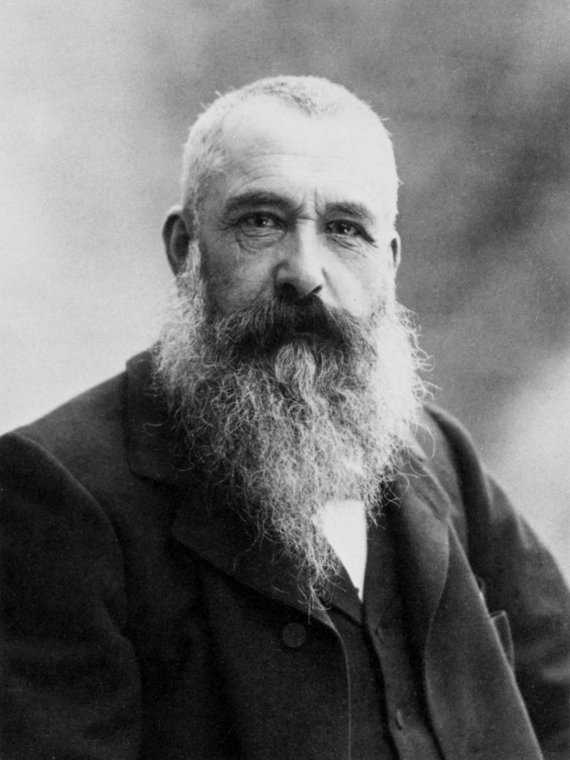
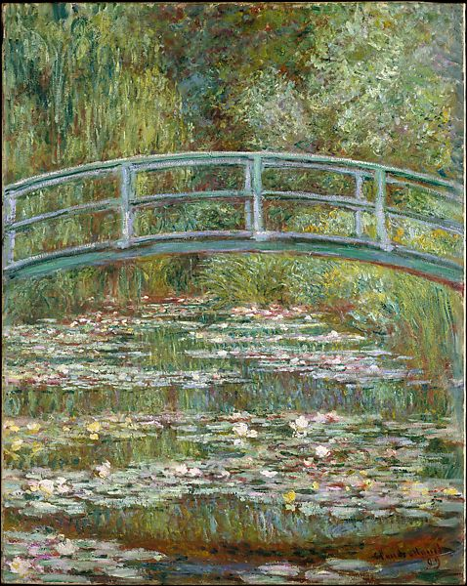
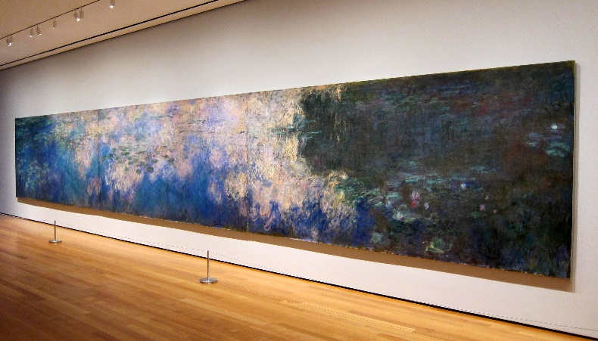
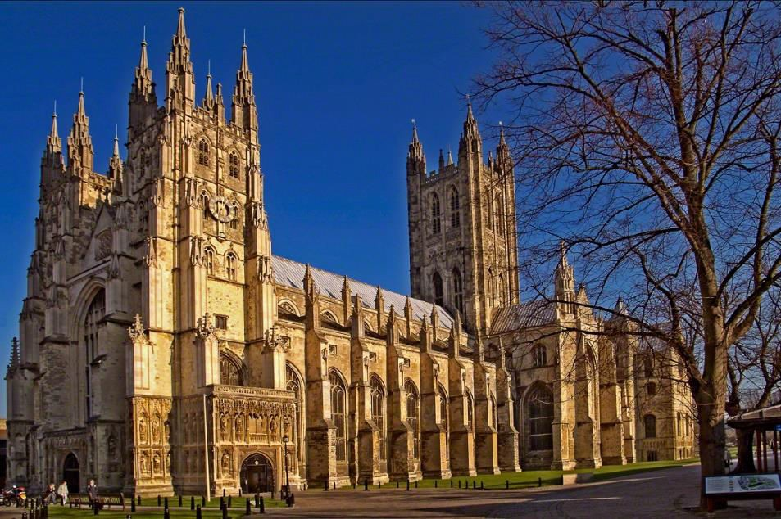
YEAR 2
Term 2
Monet - art
How can I create different marks in paint?
Key Vocabulary
primary colour
secondary colour
Monet
Impressionism
landscape
brushstroke
blending
mark marking
layering
texture
Claude Monet 1840 - 1926
Monet was a French artist and is considered one of the most important artists of all time.
He was the founder of the Impressionist movement – the treatment of light and movement gives the impression of a scene, rather than a true representation of it.
We can make secondary colours by mixing the primary colours.
We can alter the tone of the colours by adding more or less of each colour, or lightening by adding white
Monet is famous for landscapes, which he painted outside en plein air
Monet was particularly inspired by his waterlily pond at his home in Giverny. He painted countless pictures of the pond over a 20 year period.
Some of the paintings are vast and can be seen in museums all over the world.

