Slide 1
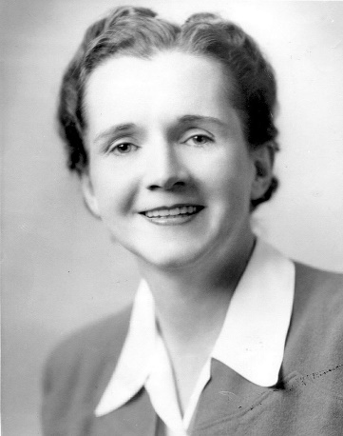
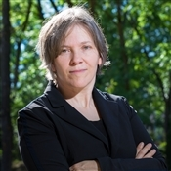
Living things and their Habitats –
Nature and the Environment
YEAR 4
Term 6
Are living things in danger?
Key Facts:
Did you know that around 450 million litres of water are wasted each year in the world?
It is estimated that the world’s reserves of oil and gas could run out in the next 50 years?
Five top tips for helping to save the planet!
Re-use and recycle plastic items
Turn off taps and only use the water you need.
Fully switch off lights and electrical items.
Encourage the use of renewable energy sources.
Walk, cycle or use public transport.
Key
Vocabulary:
Habitat
Ecology
bacteria
ecosystem environment
air pollution
climate change
water pollution deforestation
pollute
greenhouse gases
emission
chemical
contaminate
conserve
drought
pure
Key Scientists:
Cindy Looy – a plant ecologist who investigates the response of Palaeozoic plants and plant communities to environmental change during periods of mass extinction and deglaciation.
Rachel Carson – an American scientist and writer who studied the natural world ocean and the environment. Her book ‘Silent Spring’ convinced many people that the environment needed better protection. She is sometimes called the mother of the environmental movement.

