Slide 1
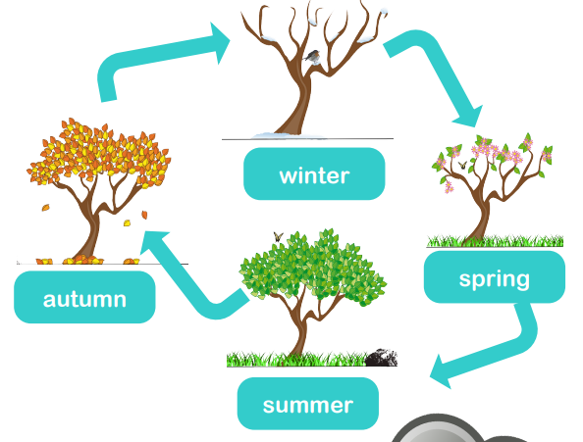
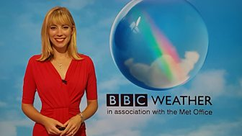
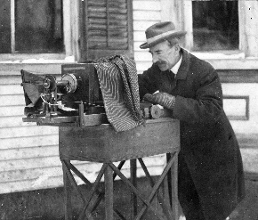
Seasonal Change
How does the weather change depending on the season?
YEAR 1
Term 4
Key Vocabulary
weather
cloudy
rain
sunny
temperature season
cloud
droplet
sky
sleet
flood
snow
thunderstorm
lightning
safety
shelter humidity
spring
summer
autumn
winter
thermometer
forecast
Key Facts
Key Scientists
Spring is the season after Winter and before Summer. In Europe flowers start to blossom and lambs are born.
Autumn is the season after summer and before winter. Trees in Europe start to change colour and lose their leaves.
Winter is the coldest season. It can snow at this time of year.
Temperature is measured in degrees Celsius by a thermometer
Weather forecasters predict what the weather will be like in the future
The coldest temperature on earth was -89.2º recorded in Antarctica
Thunderstorms and lightning usually happen when it is very hot
The hottest place on earth is Death Valley in the US, which has recorded temperatures of 56º
Wilson Bentley was a photographer. By taking thousands of photos of snowflakes, he discovered that every snowflake is different and that all snowflakes have 6 sides.
Holly Green is a meteorologist. She studies the weather and presents the weather forecast on the television.

