Slide 1
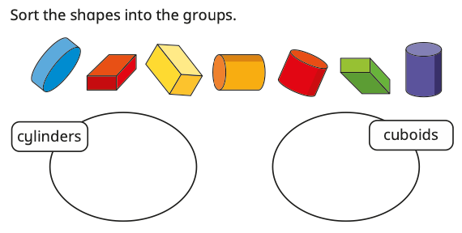
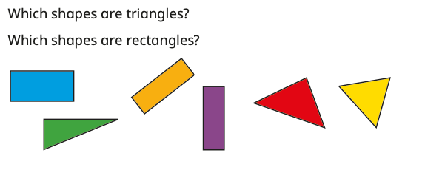
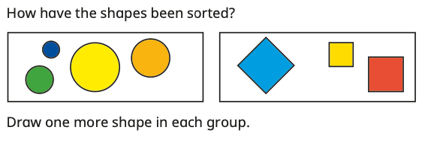
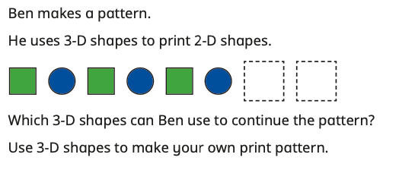
YEAR 1
Block 3
Maths – Geometry
Small Steps:
Recognise and name 3D shapes
Sort 3D shapes
Recognise and name 2D shapes
Sort 2D shapes
Patterns with 2D and 3D shapes
Key Questions:
What makes a shape 3D?
What is the name of this 3D shape?
Does the shape change when you turn it around?
What does 2D mean?
What is the difference between a 3D and a 2D shape?
Describe the difference between a ______ and a ______
How have the shapes been sorted?
What is the same about the shapes? What is different?
What do the shapes in this group have in common?
Why is this shape the odd one out?
Could the shapes have been sorted in a different way?
What is the order of the shapes in the pattern?
Can you describe the pattern?
What shape will be next?
Key
Vocabulary:
2D
3D
side
face
curved surface
circle
triangle
quadrilateral
square
rectangle
pentagon
hexagon
octagon
sphere
cone
cylinder
cuboid
cube
pyramid
sort
group
pattern
symmetrical
repeating
Stem Sentences:
The mathematical name of a football is a ______
The mathematical name of a can is a ______
This is a ______ because …
A ______ has flat faces
A ______ has a curved surface
A ______ has both flat faces and curved surfaces
I know this shape is a ______ because …
I have sorted the shapes by ______
These shapes are grouped together because …
The pattern is made up of ______ shapes
The next shape in the pattern is a ______

