Slide 1
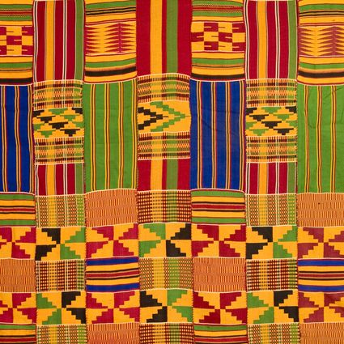
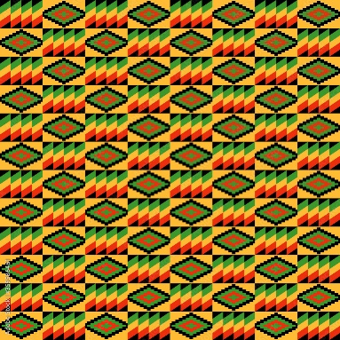
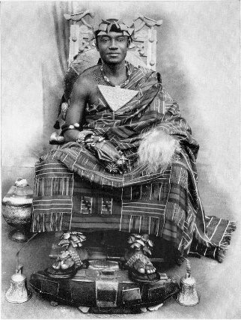
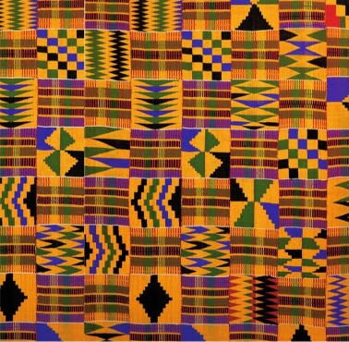
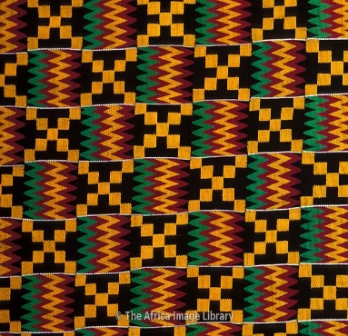
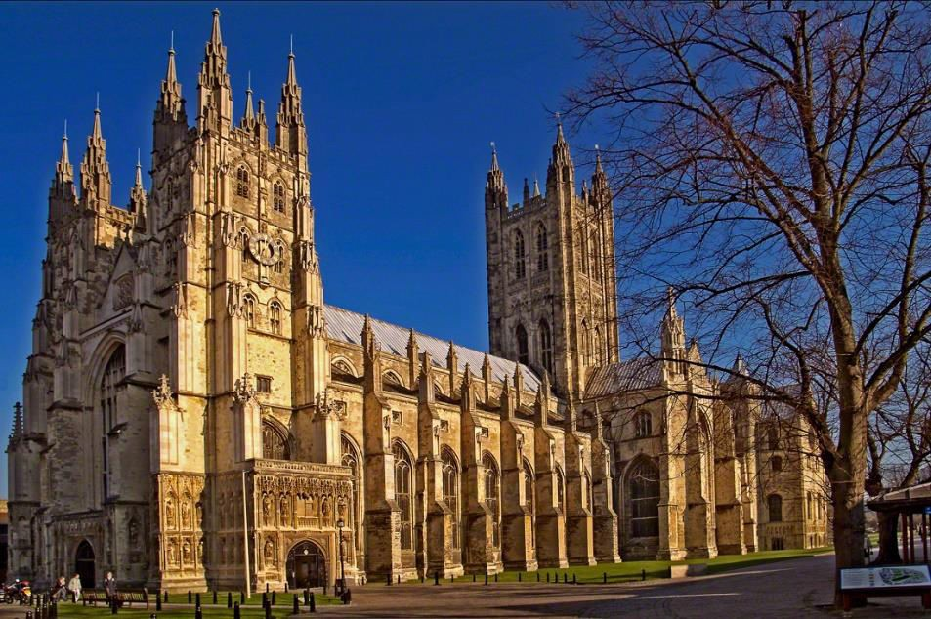
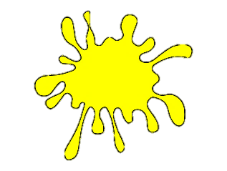
YEAR 1
Term 2
Kente Cloth Patterns - art
What is a repeating pattern?
Key Vocabulary
cloth
Kente
Ghana
repeating pattern
geometric shape
printing
colour mixing
Kente Cloth
Kente is a Ghanaian cloth made of handwoven strips of silk and cotton
Historically the fabric was worn in a toga-like fashion by royalty
In modern day Ghana, the wearing of Kente cloth has become widespread to commemorate special occasions
The colours of Kente cloth represent the colours of the country, but also have different meanings e.g. red means political and spiritual moods
Kent cloth uses repeating and geometric patterns
The cloth represents high value
+
=
+
=

