Slide 1
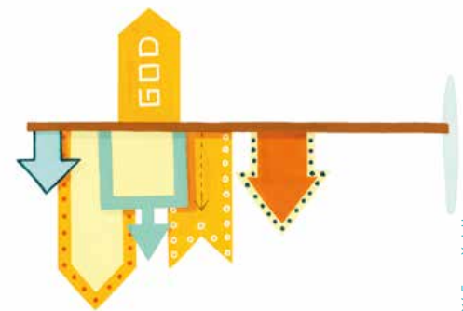
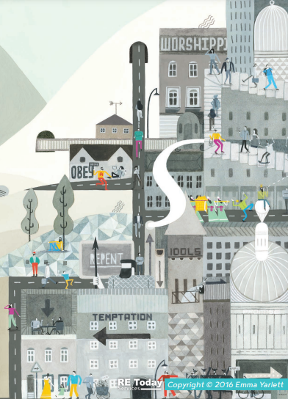
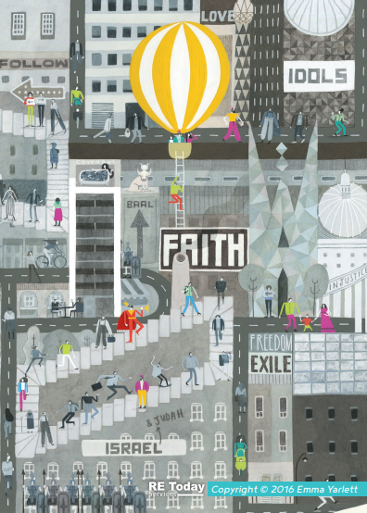
What is it like to follow God?
YEAR 3
Term 1
People of God
Key Vocabulary
Old Testament
command
covenant
promise
faith
trust
Fall
descendants
Knowledge Building Blocks
Key Bible Stories
Genesis 6:5–9:17
Noah is called by God to build an ark for himself and his family
Noah is told to bring two of all living creatures, male and female and keep them alive in the ark
God sends rain for 40 days and nights and after 7 days the world is flooded
God sends the flood to bring good into the world and wipe out evil
Eventually the floods go down and Noah sends out a dove who returns with a leaf to show that the world is no longer covered in water
Noah, his family and the animals come out of the ark to create future generations
The Old Testament tells the story of a particular group of people, the children of Israel known as the People of God — and their relationship with God.
The People of God try to live in the way God wants, following his commands and worshipping him.
They believe he promises to stay with them and Bible stories show how God keeps his promises.

