Slide 1
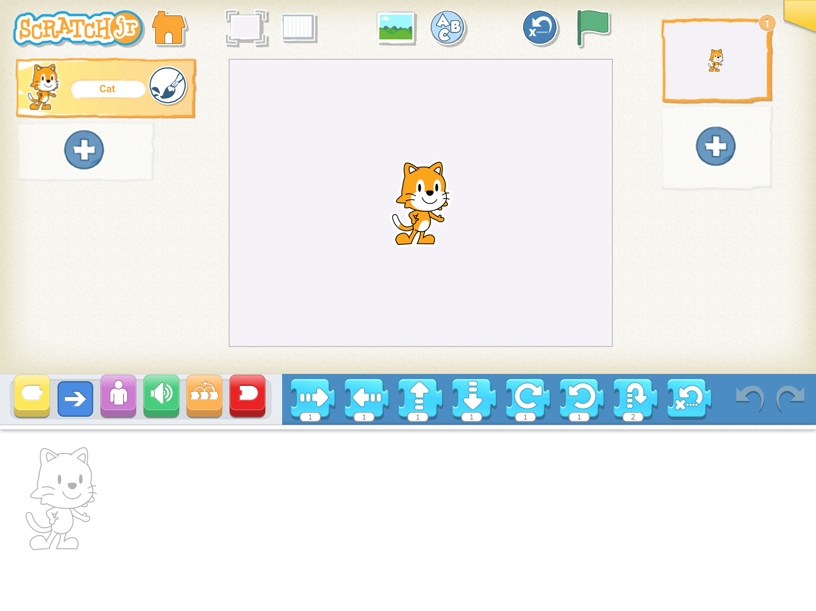
YEAR 2
Term 6
Programming B – An Introduction to Quizzes
Key
Vocabulary:
series
instructions
sequence
enacted
order
commands
programme
predict
outcome
test
create
debug
device
Scratch Jr.
green flag
blocks
animation
algorithm
Characters/sprite
backgrounds
Knowledge Building Blocks:
To describe a series of instructions as a ‘sequence’.
To choose a series of words that can be enacted as a sequence.
To explain what happens when we change the order of instructions.
To recall that a series of instructions can be issued before they are enacted.
To choose a series of commands that can be run as a programme.
To use logical reasoning to predict the outcome of a programme.
To trace a sequence to make a prediction.
To test a prediction by running the sequence.
To create and debug a programme that I have written.
To run a programme on a device.
Application:
Sequence and Outcomes:
Scratch Jr Layout:
Homepage
Change the background
Add a new Sprite
Full Screen
Move blocks

