Slide 1
YEAR 4
Stage 2
Autumn 2
Spanish
Robot Town – Classroom Commands
Knowledge Building Blocks:
I can write my own fireworks poem.
I can read and understand and write some useful instructions.
Key Vocabulary:
Verb Bank
All the words below are part of verbs when we instruct one person to do something.
Mira- look
Escucha- listen
Repite- repeat
Levántate- stand up
Siéntate- sit down
Cuenta- count
Canta- sing
Enséñame- show me
Busca – look for
Verb Bank
All the words below are part of verbs when we instruct more than one person to do something.
Mirad- look
Escuchad- listen
Repetid- repeat
Levantaos- stand up
Sentaos- sit down
Contad- count
Cantad- sing
Enseñadme - show me
Buscad – look for
Sound spelling
“uch”
“ite”
“aos”

Slide 2
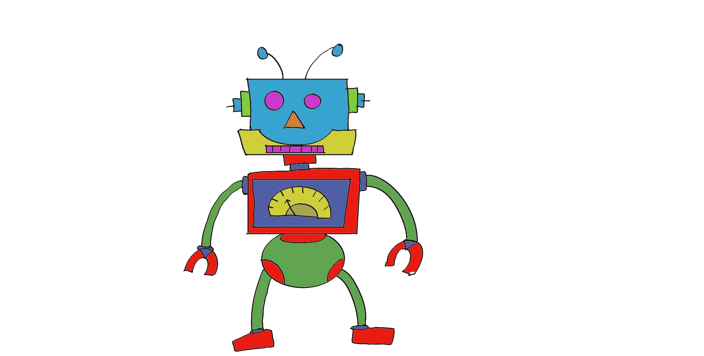
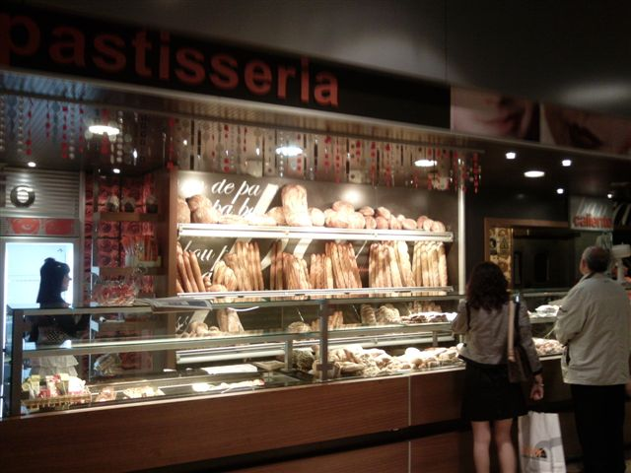
YEAR 4
Stage 2
Autumn 2
Spanish
Robot Town – Towns and Shops
Knowledge Building Blocks:
I can say and recognise places in a town.
I can give simple directions and ask “Where is…?” in Spanish.
Key Vocabulary:
Question and Answer Bank
¿Dónde está….?- Where is ….?
Aquí está… - Here is ……
Noun Bank
El café- the cafe
El cine the cinema
El restaurante – the restaurant
El supermercado- the supermarket
El estadio – the stadium
La carnicería- the butchers
La panadería- the bakers
La farmacia- the chemist
La escuela – the school
¿Dónde está… ?
Sound spelling
“qui”
“cuela”

